Slide 1
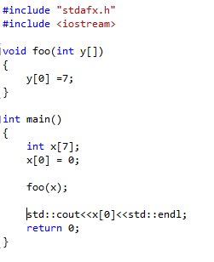
What is the output?
Output: 7

Slide 2
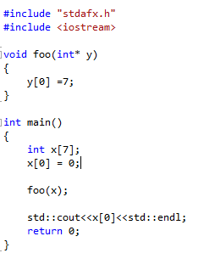
What is the output?
Output: 7

Slide 3
Arrays and Parameters

Slide 4
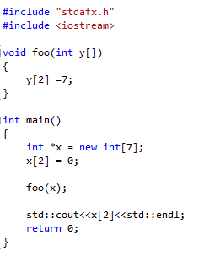
What is the output?
Output: 7

Slide 5
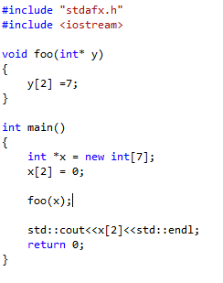
What is the output?
Output: 7

Slide 6
Arrays and Parameters

Slide 7
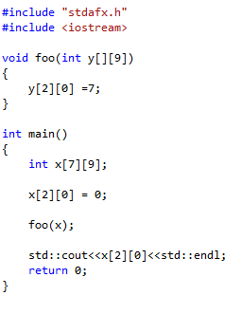
What is the output?
Output: 7

Slide 8
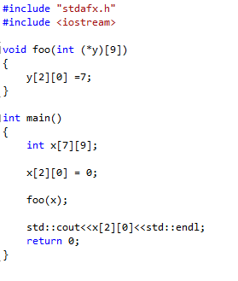
What is the output?
Output: 7

Slide 9
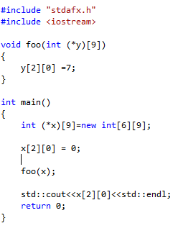
What is the output?
Output: 7

Slide 10
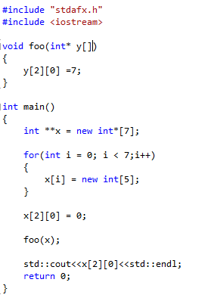
What is the output?
Output: 7

Slide 11
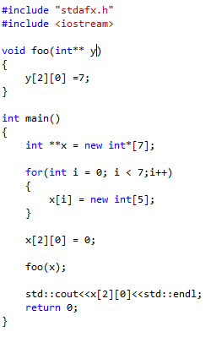
What is the output?
Output: 7

